Slide 1


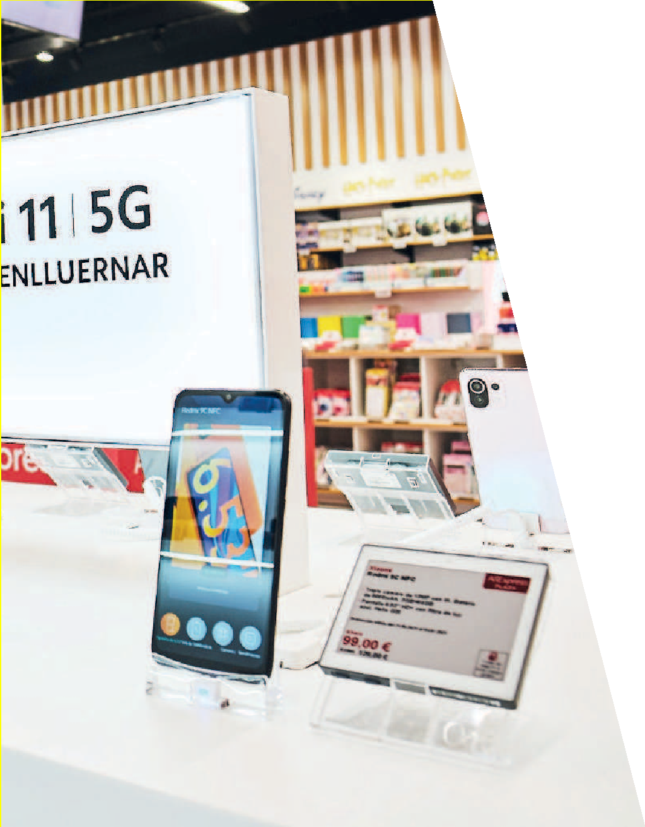
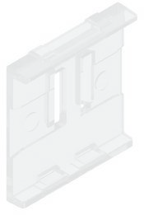
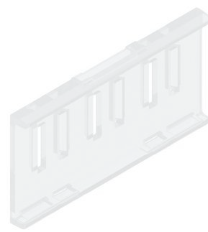
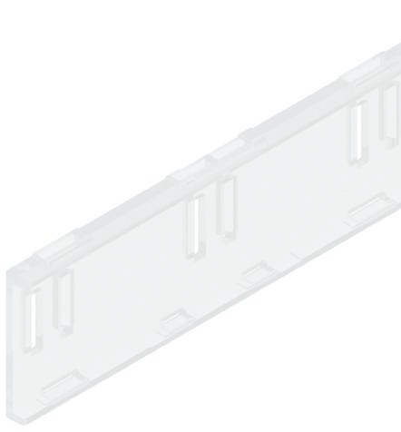
ESL SUPPORTS
For “NEWTON” electronic labels
In this catalog, you will find the widest assortment of supports designed specifically for the “NEWTON ESL SOLUM”
All brackets are specifically designed for being applied with each model of electronic label.
CATALOGUE
20
23

Slide 2


Supports for electronic labels Solum / Catalogue 2023
In this catalog, you will find the widest assortment of supports designed specifically for the “NEWTON ESL SOLUM”.
All brackets are specifically designed for being applied with each model of electronic label.
CATALOGUES
See our “accessories” and “shelf profiles” catalogs where you will find the widest assortment of designed items specifically for solum newton electronic labels.
Most have inserts that, in combination with our accessories, allow each label model to be displayed in different positions so that they adapt to any type of furniture or surface, adapting to any situation that you need in your business.
In cases where these supports come into contact with food, the materials with which they that have been manufactured are especially made for food use.
ACCESORIES
In this catalog you will find the widest assortment of ACCESSORIES
compatible with the supports and boxes designed for the “NEWTON ESL SOLUM”.
If you do not find the product you need, contact us and we will develop it in the shortest possible time.
To facilitate the search for the appropriate support for the SOLUM electronic label model that you have chosen for your trade, this catalog has been segmented according to the labels’ sizes.
These accessories will allow you, among other things, to vary the height and inclination when implanting your labels, fasten them on wooden, metal or glass shelves, fix them in baskets, boxes or on edges of any thickness, and hang them on tubes and rods, among others. Applications. For large format labels, you can hang them on suspended profiles, place them on telescopic tubes or fix them with magnets on metal surfaces.
You can find the appropriate label size and supports in the identified chapters with its color.
The perfect combination of accessories with injection parts guarantees that there will be no product in your store where you cannot mark its price with SOLUM electronic labels.
INDEX
SUPPORTS
FOR NEWTON ELECTRONIC LABELS
PAGE
If the accessory you need is not in this chapter, please consult us and we will develop it in a short space of time.
04
TO 08
OVS: Supports for Newton ESL Solum Small format
10
TO 17
OVM: Supports for Newton ESL Solum Medium format
SHELF PROFILES
Our catalog represents a large assortment of profiles for the different types of shelves on the market.
18
TO 18
Special concepts for electronics
If the profile you need is not in this catalog, we can develop it in a short period of time.
We keep a permanent stock of all referenced models in lengths of 985 and 1315 mm and in transparent and black COLORS.
19
TO 19
Accesories for Newton ESL Solum
All our profiles are made of a single piece; that is, they are inserted directly into the front of the shelf without requiring any assembly or other manipulations.
20
TO 21
Promo system
3

Slide 3
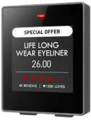
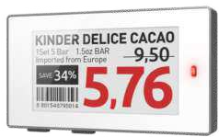
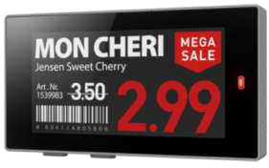
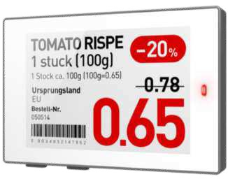

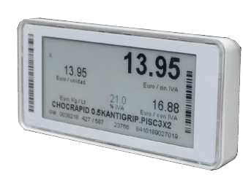
Supports OVS for electronic labels Solum / Catalogue 2023
Supports OVS for electronic labels Solum / Catalogue 2023
1.6
2.2
2.6
OVS
SUPPORTS FOR “NEWTON ESL SOLUM”
SMALL FORMAT
FOR SOLUM 1.6 LABELS
FOR SOLUM 2.2, 2.6 AND 2.7 LABELS
FOR SOLUM 2.9 LABELS
FOR SOLUM 2.9 “ METRO / MAKRO” LABELS
MAGNETIC SUPPORT FOR SOLUM 2.2, 2.6 ,2.7, 2.9 AND 4.2 LABELS
MAGNETIC SUPPORT FOR SOLUM 1.6 LABELS
2.7
2.9
2.9
METRO/ MAKRO
4
5

Slide 4
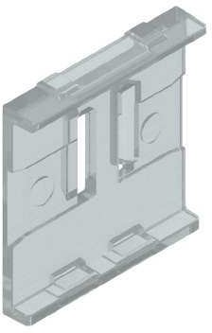
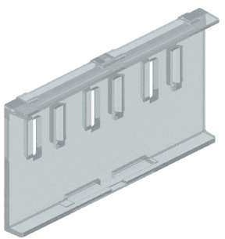
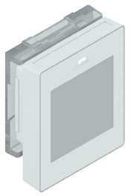
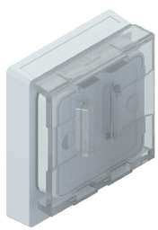
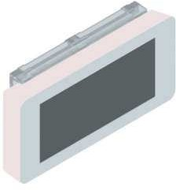
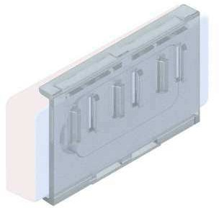
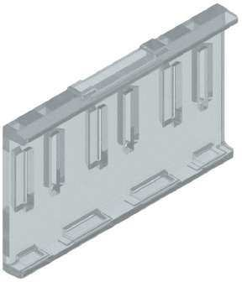
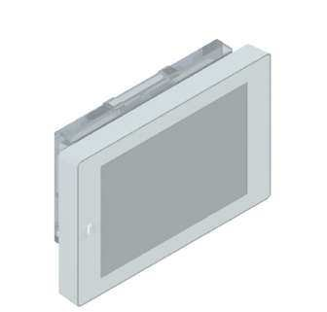
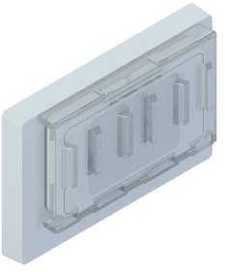
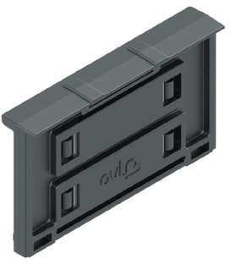
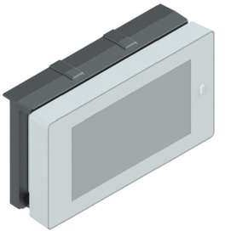
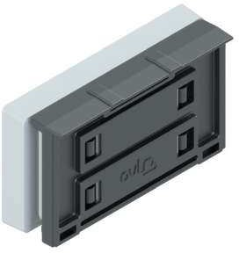
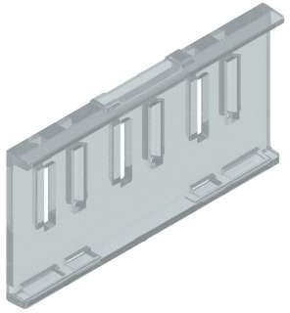
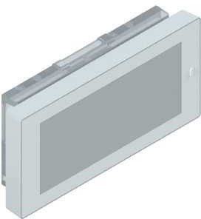
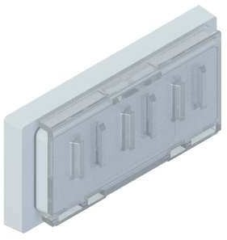
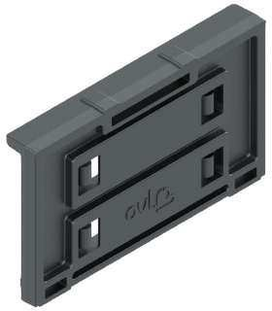
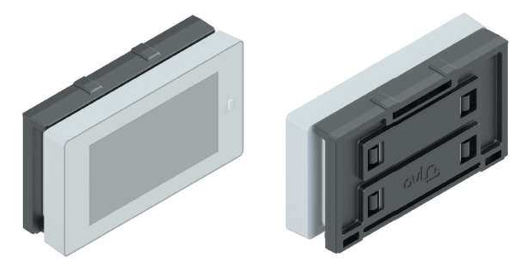
Supports OVS for electronic labels Solum / Catalogue 2023
OVS
Supports OVS for electronic labels Solum / Catalogue 2023
SUPPORTS FOR “NEWTON ESL SOLUM”
SMALL FORMAT
CODE | LABELS | COLOR | MATERIAL |  | CODE | LABELS | COLOR | MATERIAL
01000-00 | 1.6 | Transparent / Black | Polycarbonate |  | 01035-00 | 2.9 | Transparent | Polycarbonate
01020-00 | 2.2, 2.6 & 2.7 | Transparent / Black | Polycarbonate |  | 01072-05 | 2.2 / 2.6 / 2.7 / 2.9 / 4.2 | Black | ABS
01030-00 | 2.9 | Transparent / Black | Polycarbonate |  | 01073-05 | 2.2 / 2.6 / 2.7 / 2.9 / 4.2 | Black | ABS
Box units: 100 supports.
Minimum order: 1 box.
Box units: 100 supports.
Minimum order: 1 box.
01000-00
FOR SOLUM 1.6 LABELS
01035-00
FOR SOLUM 2.9 “METRO/MAKRO” LABELS
01020-00
FOR SOLUM 2.2, 2.6 AND 2.7 LABELS
01072-05
MAGNETIC SUPPORT FOR SOLUM 2.2, 2.6, 2.7 & 4,2 LABELS
*With two magnets and alingner on the back.
01030-00
FOR SOLUM 2.9 LABELS
01073-05
MAGNETIC SUPPORT FOR SOLUM 2.2, 2.6, 2.7 & 4,2 LABELS
*With two magnets without alingner on the back.
6
7

Slide 5
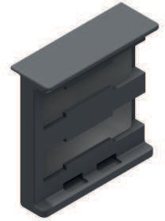
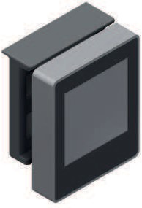
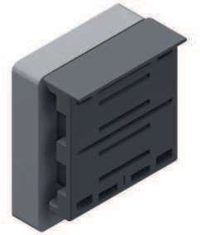
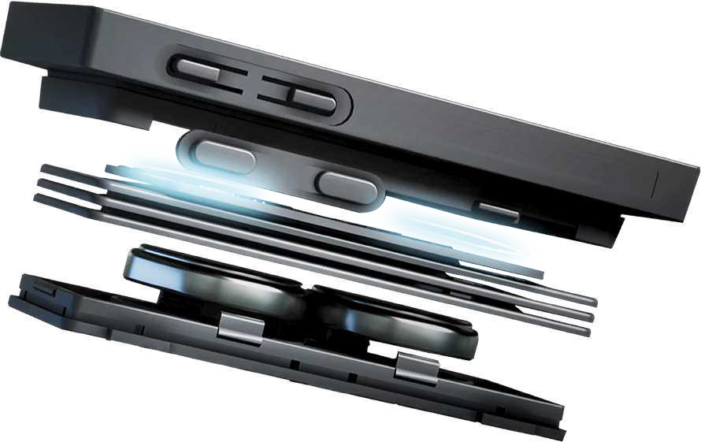
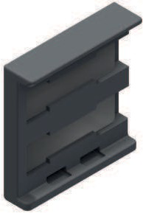
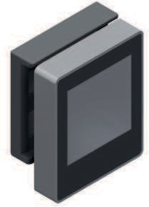
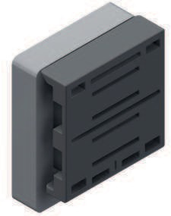

Supports OVS for electronic labels Solum / Catalogue 2023
OVS
SUPPORTS FOR “NEWTON ESL SOLUM”
SMALL FORMAT
CODE | LABELS | COLOR | MATERIAL
01082-05 | 1.6 | Black | ABS
01083-05 1.6 Black ABS
The Newton System
Box units: 100 supports.
Minimum order: 1 box.
01082-05
MAGNETIC SUPPORT FOR SOLUM 1.6 LABELS
*With two magnets and alingner on the back.
01083-05
MAGNETIC SUPPORT FOR SOLUM 1.6 LABELS
*With two magnets without alingner on the back.
8

Slide 6
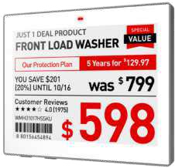
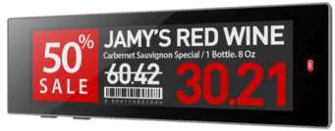
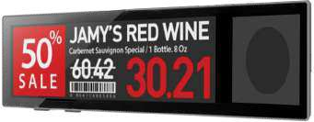
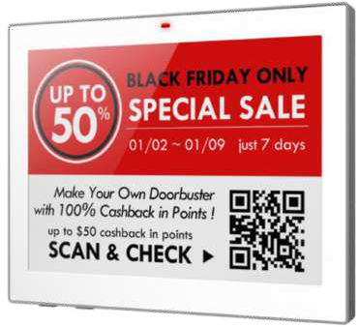
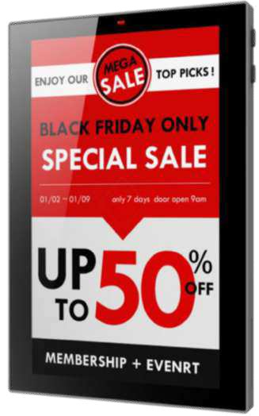
Supports OVM for electronic labels Solum / Catalogue 2023
Supports OVM for electronic labels Solum / Catalogue 2023
4.2
OVM
4.3
SUPPORTS FOR “NEWTON ESL SOLUM”
MEDIUM FORMAT
4.3
INDUSTRIAL
SMALL SIZE SUPPORT FOR SOLUM 4.2 LABELS
FLAT SUPPORT STANDARD SIZE FOR SOLUM 4.2 LABELS
FLAT SUPPORT STANDARD SIZE FOR SOLUM 4.2 LABELS
BASIC MODEL INCLINED SUPPORT FOR SOLUM 4.2 LABELS
INCLINED SUPPORT WITH ADHESIVE STRIPS ON THE BASE FOR SOLUM 4.2 LABELS
INCLINED SUPPORT WITH MAGNETIC STRIPS ON THE BASE FOR SOLUM 4.2 LABELS
INCLINED SUPPORT WITH SUCTION CUP ON THE BASE FOR SOLUM 4.2 LABELS
6.0
INCLINED SUPPORT WITH GUIDE AND SCREW ON THE BASE FOR SOLUM 4.2 LABELS
(SPECIAL “EL CORTE INGLÉS”)
SUPPORT FOR SOLUM 4.3 LABELS
SUPPORT FOR SOLUM 4.3 INDUSTRIAL LABELS
SUPPORT FOR SOLUM 4.3 INDUSTRIAL LABELS
REDUCE SIZE SUPPORT FOR SOLUM 6.0 AND 7.5 LABELS IN CRYSTAL-COLORED POLYCARBONATE
REDUCE SIZE SUPPORT FOR SOLUM 6.0 AND 7.5 LABELS IN GRAY-COLORED POLYCARBONATE
STANDARD SIZE SUPPORT FOR SOLUM 6.0 LABELS
7.5
STANDARD SIZE SUPPORT FOR SOLUM 7.5 LABELS
10
11

Slide 7
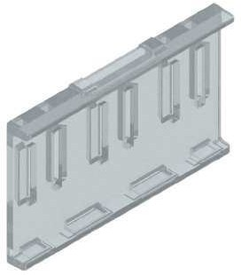
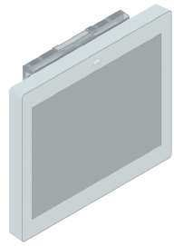
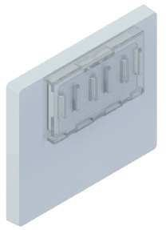
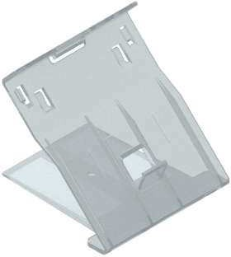
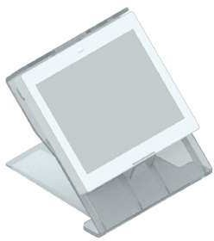
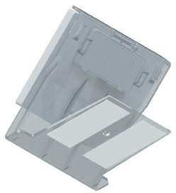
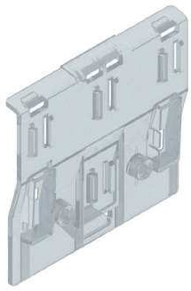
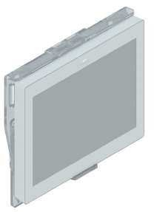
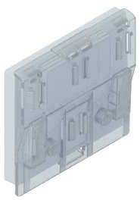
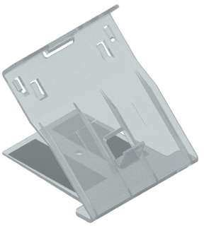
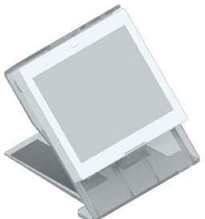
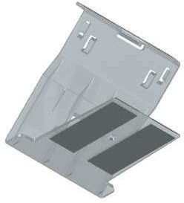






Supports OVM for electronic labels Solum / Catalogue 2023
OVM
Supports OVM for electronic labels Solum / Catalogue 2023
SUPPORTS FOR “NEWTON ESL SOLUM”
MEDIUM FORMAT
CODE | LABELS | COLOR | MATERIAL |  | CODE | LABELS | COLOR | MATERIAL
01020-00 | 4.2 | Transparent / Black | Polycarbonate |  | 01110-00 | 4.2 | Transparent / Black | Polycarbonate
01090-00 | 4.2 | Transparent / Black | Polycarbonate |  | 01120-00 | 4.2 | Transparent / Black | Polycarbonate
01100-00 | 4.2 | Transparent / Black | Polycarbonate |  | 01130-00 | 4.2 | Transparent / Black | Polycarbonate
Box units: 100 supports.
Minimum order: 1 box.
Box units: 25 supports.
Minimum order: 1 box.
01020-00
FOR SOLUM 4.2 LABELS
01110-00
INCLINED SUPPORT WITH ADHESIVE STRIPS ON THE BASE FOR SOLUM 4.2 LABELS
01090-00
FLAT SUPPORT STANDARD SIZE FOR SOLUM 4.2 LABELS
01120-00
INCLINED SUPPORT WITH MAGNETIC STRIPS ON THE BASE FOR SOLUM 4.2 LABELS
01100-00
BASIC MODEL INCLINED SUPPORT FOR FOR SOLUM 4.2 LABELS
01130-00
INCLINED SUPPORT WITH SUCTION CUP ON THE BASE FOR SOLUM 4.2 LABELS
12
13

Slide 8











Supports OVM for electronic labels Solum / Catalogue 2023
OVM
Supports OVM for electronic labels Solum / Catalogue 2023
SUPPORTS FOR “NEWTON ESL SOLUM”
MEDIUM FORMAT
CODE | LABELS | COLOR | MATERIAL
01140-00 | 4.2 | Transparent | Polycarbonate
Box units: 100 supports.
Minimum order: 1 box.
01040-00
INCLINED SUPPORT WITH GUIDE AND SCREW ON THE BASE FOR SOLUM 4.2 LABELS
This support has tabs on the back to hold promotional supplements
Label
Support
Threaded insert
Furniture Polycarbonate Washer
Butterfly screw
14
15

Slide 9



















Supports OVM for electronic labels Solum / Catalogue 2023
OVM
Supports OVM for electronic labels Solum / Catalogue 2023
SUPPORTS FOR “NEWTON ESL SOLUM”
MEDIUM FORMAT
CODE | LABELS | COLOR | MATERIAL |  | CODE | LABELS | COLOR | MATERIAL
01200-00 | 4.3 | Transparent | Polycarbonate |  | 01300-08 | 6.0 / 7.5 | GREY RAL 7012 | Polycarbonate
01210-00 | 4.3 INDUSTRIAL | Transparent / GREY RAL 7012 | Polycarbonate |  | 01320-08 | 6.0 | GREY RAL 7012 | Polycarbonate
01300-00 | 6.0 / 7.5 | Transparent / GREY RAL 7012 | Polycarbonate |  | 01360-08 | 7.5 | GREY RAL 7012 | Polycarbonate
Box units: 100 supports.
Minimum order: 1 box.
Box units: 100 supports.
Minimum order: 1 box.
01200-00
FOR SOLUM 4.3 LABELS
01300-08
REDUCE SIZE SUPPORT FOR SOLUM 6.0 AND 7.5 LABELS IN GRAY-COLORED POLYCARBONATE
01210-00
FOR SOLUM 4.3 “INDUSTRIAL” LABELS
01320-08
STANDARD SIZE SUPPORT FOR SOLUM 6.0 LABELS
01300-00
REDUCE SIZE SUPPORT FOR SOLUM 6.0 AND 7.5 LABELS IN CRYSTAL-COLORED POLYCARBONATE
01360-08
STANDARD SIZE SUPPORT FOR SOLUM 7.5 LABELS
16
17

Slide 10














Supports OVL for electronic labels Solum / Catalogue 2023
OVM
Supports for electronic labels Solum / Catalogue 2023
SUPPORTS FOR “NEWTON ESL SOLUM”
SPECIAL CONCEPTS FOR ELECTRONICS
ACCESORIES
FOR “NEWTON ESL SOLUM”
CODE
LABELS
MATERIAL
CODE
MATERIAL
OVM 01085 01
2.7
Polycarbonate
09001-15
ABS
OVM-01095-01
4.2
Polycarbonate
Minimum order: 1 pc.
OVM-01098-01
4.2
Polycarbonate
OVM-01365-01
7.5
Polycarbonate
09001-15
ELECTRONIC LABEL REMOVER TOOL
OVM-01367-01
7.5 Polycarbonate
Consult us minimum order and price.
CONCEPTS
2.7
4.2
4.2
To remove labels from the supports or adapters.
To remove labels from the rails or profiles.
7.5
7.5
UNIVERSAL CLIP TO PLACE PROMOTIONAL SUPPLEMENTS
The universal promotional supplement clip fits all media designed for each SOLUM label size with the exception of special magnetic supports (OVS 01072-05 and OVS 01073-05), and inclined support for 4.2 labels (OVM 01100-00, OVM 01110-00, OVM 01120-00, OVM 01130-00, and OVM 01140-00).
02405-00
PROMO HOLDER CLIP
02415-00
CONNECTOR WITH ADHESIVE
18
19

Slide 11
















APPLICATION
IN THE ESL SOLUM 4.2 (STANDARD SIZE SUPPORT)
Supports for electronic labels Solum / Catalogue 2023
PROMO
SYSTEM
APPLICATION
IN THE ESL SOLUM 6.0 (STANDARD SIZE SUPPORT)
APPLICATION
IN THE ESL SOLUM 7.5 (STANDARD SIZE SUPPORT)
We can produce
any promotional supplement in size, shape, colors and with adapted design to your bussines electronic labels.
Highlight your sales, promotions, product eatures and everythig you want to get your coustomer’s attention.
APPLICATION
IN ALL SMALL SUPPORTS
APPLICATION
IN THE ESL SOLUM 11.6
20
21

Slide 12





contact us
www.smartdigit.pt
info@smartdigit.pt
+351 211 165 222

